Slide 1

Real estate investment analysis
Manoj eega

Slide 2

Client Wishes to invest in real estate sector
Properties in New York City Identified that two-bedroom properties to be the best investments
Goal To identify zip codes where the investments will be most profitable

Slide 3




Data sources
01
Zillow Data
Historical property values in different zip codes across USA
02
Airbnb data
Information about rental listings of various zip codes like price, occupancy etc

Slide 4




Approach - overview
Data cleaning and transformations
Feature Engineering
Break even calculations
Explore Profitability
Critical data selection, uniform date formats, appropriate data formats, wide format to long format
New variables for analysis. Combined different data sources to obtain a single dataset
Evaluate break even for zip codes
Evaluate profitability in the long run and very long run

Slide 5
Assumptions
Given :
An occupancy rate of 75%
Time value of money discount rate is 0%
Investor pays for the property upfront in cash
Additional Logical Assumptions :
Rent of a ‘m’ bedroom property is m/n times of that of a ‘n’ bedroom property
Indirect discounts due to bulk bookings and special promotional discounts were not taken into consideration
Cleaning fee covers cleaning costs

Slide 6
Data cleaning
Missing Value Treatment 1% of the entries found with missing zip codes, eliminated them after making sure the missing value distribution is even among all the neighborhood
Filtering New York entries (Listings Data) Filtered zip codes pertaining to New York city after missing value treatment
Goal Oriented approach to filter critical parameters

Slide 7
Investment Parameter selection
Investment Factors | Assumptions | Remarks
Median Price of the property | Latest available Median price data taken as price at the time of investment | "RegionName" and "x2017.06" are to be checked
Investment for each zipcode = Latest Available Median Price

Slide 8
Revenue parameter selection
Revenue Factors | Assumptions | Remarks
Rent |  | "zipcode", "Price", "monthly_price","weekly_price" to be checked
Bedrooms | Rent of a 'm' bedroom property is m/n times of that of a 'n' bedroom property | "bedrooms"
Occupancy | Occupancy assumed to be 75% | So we can filter out measures relating to reviews, host qualities, bookability, web urls, neighborhood, latitude & longitude
Cleaning fee | Cleaning fee assumed to cover cleaning costs | Impact on revenue is zero
Indirect discounts due to bulk bookings | Assumed to be zero | Impact on revenue is zero
Special Promotional Discounts | Assumed to be zero | Impact on revenue is zero
Total Revenue = Occupancy rate x Average Rent x No. of days

Slide 9
Primary variable selection
ListingsNY : “zipcode”, “Price”, “monthly_price”,“weekly_price” , “bedrooms”
Median Price Data : “RegionName”(zipcode) , “x2017.06” (Latest Median Price data)

Slide 10
initialization
Data Quality Insights of critical Parameters
Nearly 90 percent of “monthly_price” , “weekly_price” entries have missing values
0.04% of entries of “bedrooms” have missing values, they are filtered out
Critical Parameters for final analysis
ListingsNY : "zipcode","price","bedrooms“
Median Price Data : "RegionName“(zipcode),"X2017.06“(Latest_Median_Price)
These two filtered lists are joined for further analysis

Slide 11
initialization
After joining the median price data with the listings data, data for 25 zip codes remain
Of these 25 zip codes , the ones with insignificant sample size have been filtered out
Remaining data of 19 zip codes have been used for further analysis
Merged the listings data and Median price data to get both revenue and median price into one dataset

Slide 12
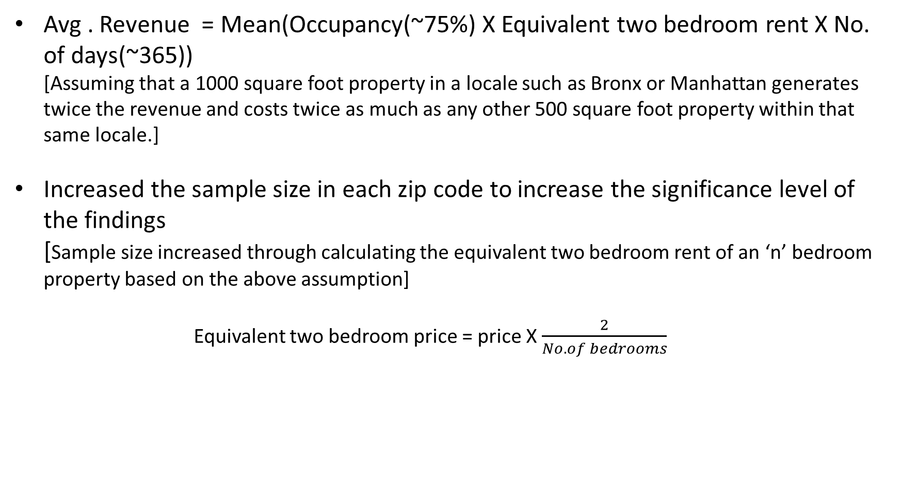
Transformed data
Avg . Revenue = Mean(Occupancy(~75%) X Equivalent two bedroom rent X No. of days(~365)) [Assuming that a 1000 square foot property in a locale such as Bronx or Manhattan generates twice the revenue and costs twice as much as any other 500 square foot property within that same locale.]
Increased the sample size in each zip code to increase the significance level of the findings [Sample size increased through calculating the equivalent two bedroom rent of an ‘n’ bedroom property based on the above assumption] Equivalent two bedroom price = price X $\frac{2}{No. of bedrooms}$

Slide 13
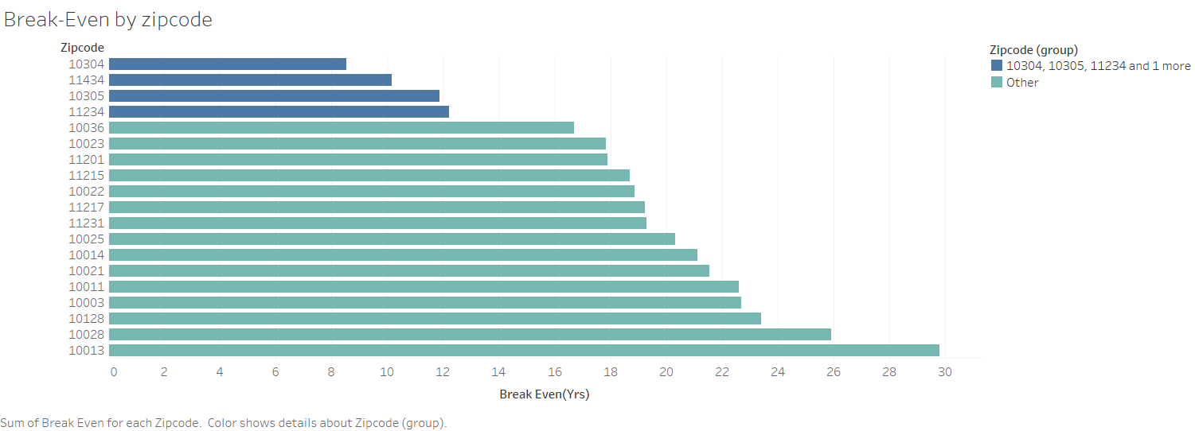
Results

Slide 14
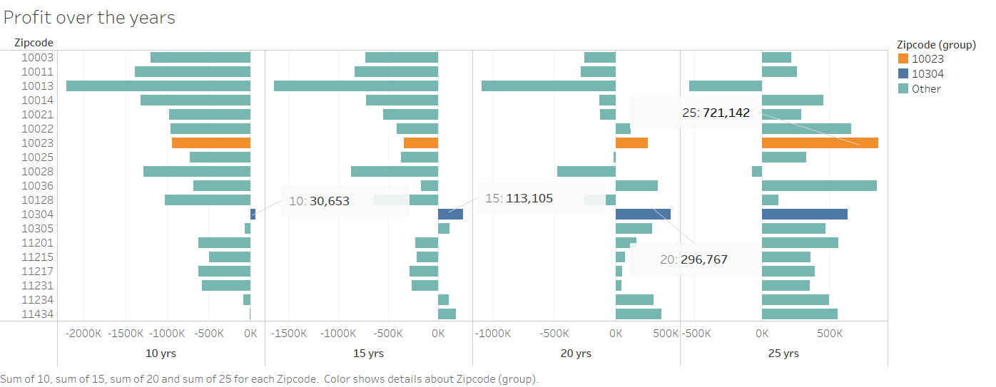
Results

Slide 15
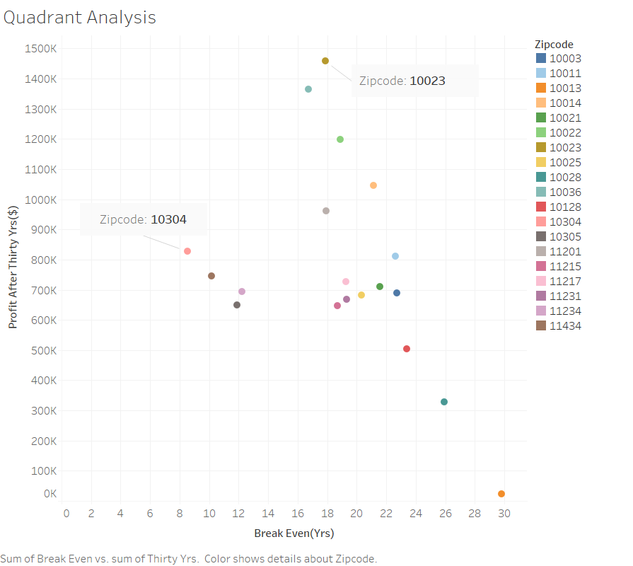
Results

Slide 16
Future improvements
Explore more business case scenarios
Build interactive dashboards using Rshiny
Areal heat maps to represent results
Square footage information will help us understand price better
98% listings missing square footage information
Next step : Richer data or extrapolation using ML techniques
Weekly prices and multi-day bookings to be incorporated in analysis
Only 25 New York zip codes in Zillow data restricting analysis
Prices taken are from a single point in time.
Historical price data will help analyze price trends

Slide 17

Thank you!
Manoj eega
eegamk@mail.uc.edu

Slide 18
Image references
Pexels.com
Capital one Facebook, LinkedIn

